Slide 1
QUIZ 3 Presentation
CET241SU10 – Introduction to embedded microcontrollers
Neil Cabrera
27-August 2019

Slide 2
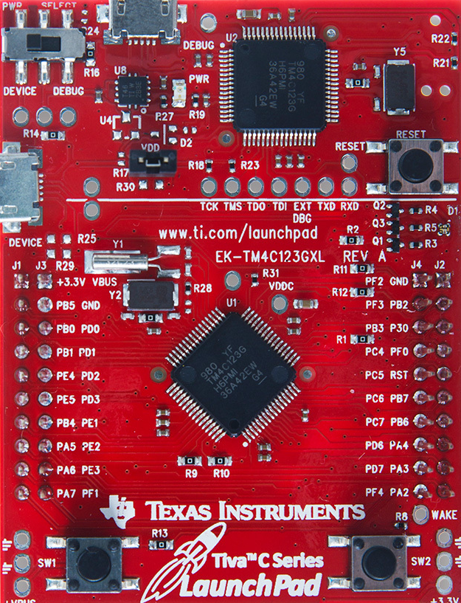
Table of contents
Stepper Motor Control (using FSM)
Distance Measurement (ADC)
Digital Piano (DAC)
Common Problems
Lessons Learned

Slide 3


1. Stepper motor control (using FSM)
Design
Solution
Demo

Slide 4
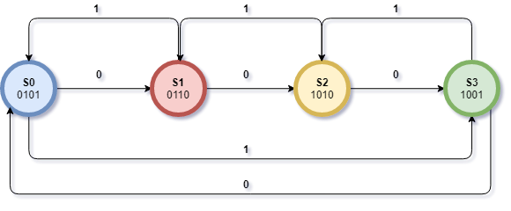
1.1 design using fsm
State | Input-0 (CCW) | Input-1 (CW) | Output
S0 | S1 | S3 | 0x05
S1 | S2 | S2 | 0x06
S2 | S3 | S1 | 0x0A
S3 | S0 | S0 | 0x09
Control Mechanism for Stepper Motor using FSM

Slide 5
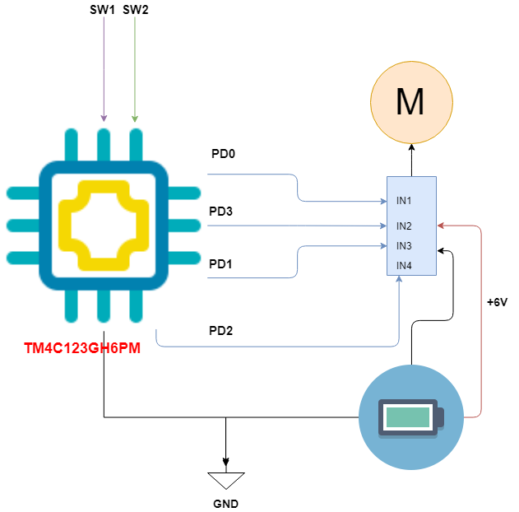
1.2 SOLUTION
SW1 – Configured for CCW
SW2 – Configured for CW

Slide 6
1.3 DEMO

Slide 7
2. Distance Measurement (ADC)
Design
Solution
Demo

Slide 8
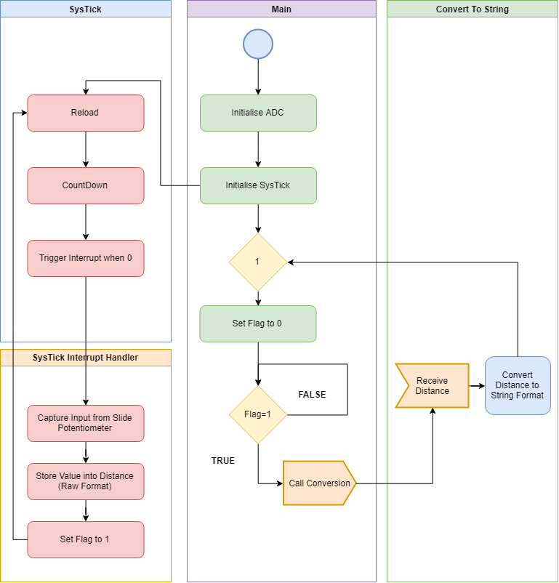
2.1 DESIGN

Slide 9
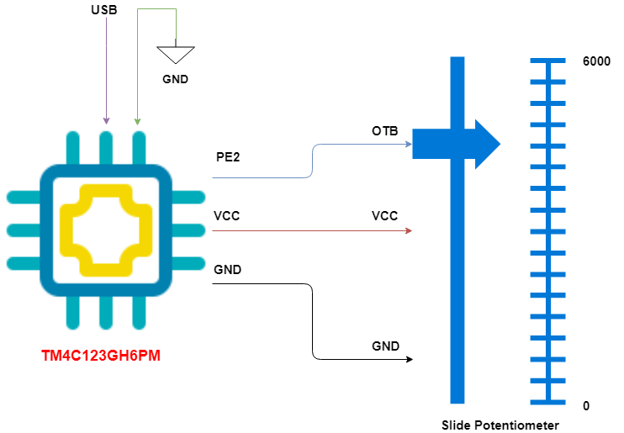
2.2 Solution
** Power to be Supplied via Computer USB Port **

Slide 10
2.3 DEMO

Slide 11
3. DIGITAL PIANO (DAC)
DESIGN
Solution
Demonstration

Slide 12
3.1 Design
 | 32 samples | precision (4bits) max= | 15
 | time | y=p/2+(p-1)/2(sin(time)) | roundoff
0 | 0 | 7.5 | 8
1 | 0.19635 | 8.865632 | 9
2 | 0.392699 | 10.17878 | 10
3 | 0.589049 | 11.38899 | 11
4 | 0.785398 | 12.44975 | 12
5 | 0.981748 | 13.32029 | 13
6 | 1.178097 | 13.96716 | 14
7 | 1.374447 | 14.3655 | 14
8 | 1.570796 | 14.5 | 15
9 | 1.767146 | 14.3655 | 14
10 | 1.963495 | 13.96716 | 14
11 | 2.159845 | 13.32029 | 13
12 | 2.356194 | 12.44975 | 12
13 | 2.552544 | 11.38899 | 11
14 | 2.748894 | 10.17878 | 10
15 | 2.945243 | 8.865632 | 9
16 | 3.141593 | 7.5 | 7
17 | 3.337942 | 6.134368 | 6
18 | 3.534292 | 4.821216 | 5
19 | 3.730641 | 3.611008 | 4
20 | 3.926991 | 2.550253 | 3
21 | 4.12334 | 1.679713 | 2
22 | 4.31969 | 1.032843 | 1
23 | 4.516039 | 0.634503 | 1
24 | 4.712389 | 0.5 | 1
25 | 4.908739 | 0.634503 | 1
26 | 5.105088 | 1.032843 | 1
27 | 5.301438 | 1.679713 | 2
28 | 5.497787 | 2.550253 | 3
29 | 5.694137 | 3.611008 | 4
30 | 5.890486 | 4.821216 | 5
31 | 6.086836 | 6.134368 | 6

Slide 13
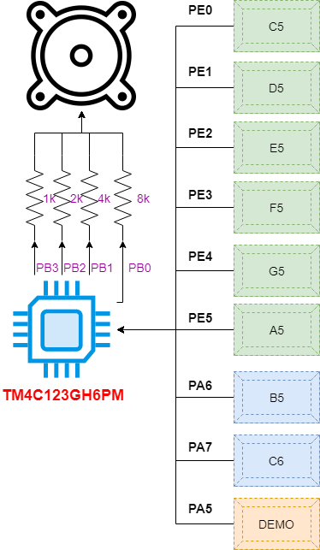
3.2 SOLUTION
Output:
4-bit DAC using PortB
Input:
6 PortE + 2 PortA
(Notes)
1 PortA
Demo Function (1 song at a time by Rotation)

Slide 14
3.3 DEMO

Slide 15
4. Common problems
Improper Sequence of Port Initialisation can cause problems or hard fault errors
Registers in the MCU are shared between different functions. Mistakes can happen and time is lost debugging the code logic when the problem is at the initisalisation.
Spacing between pins in the MCU

Slide 16
5. Lessons learned
Prepare the flow of initialisation beforehand together with the proper settings and bit locations for faster coding
For multiple projects, plan the positioning of the GPIO Ports in advance and label the wires for faster connection
Spacing between pins in the MCU

Slide 17
THANK YOU!

